Slide 1
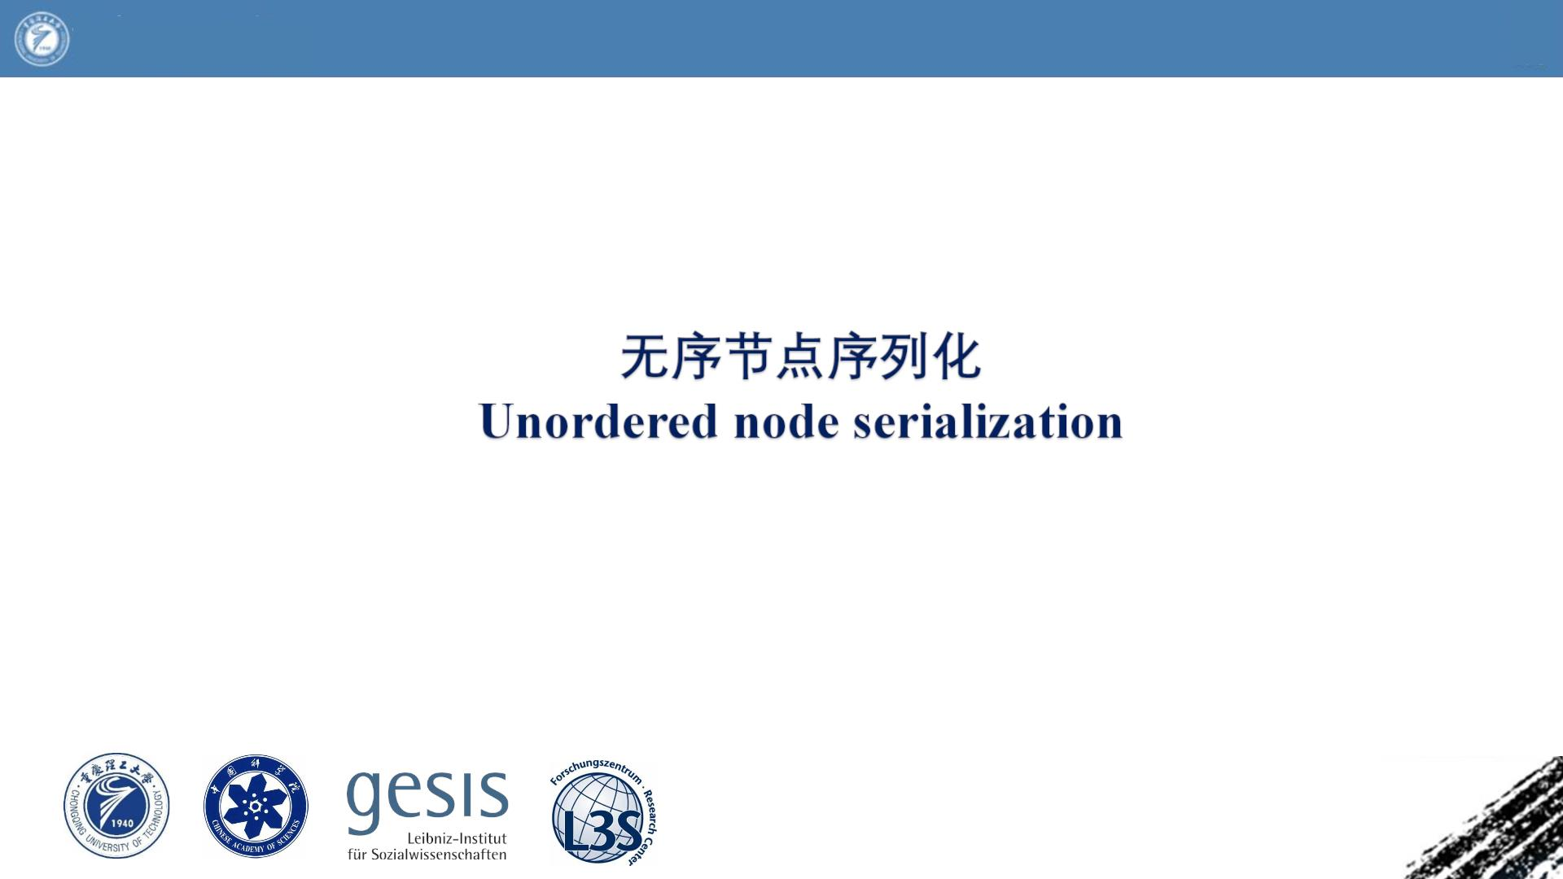
Chongqing University
of Technology
ATA I
Advanced Technique of
Artificial Intelligence
Reported by Chenghong Li

Slide 2
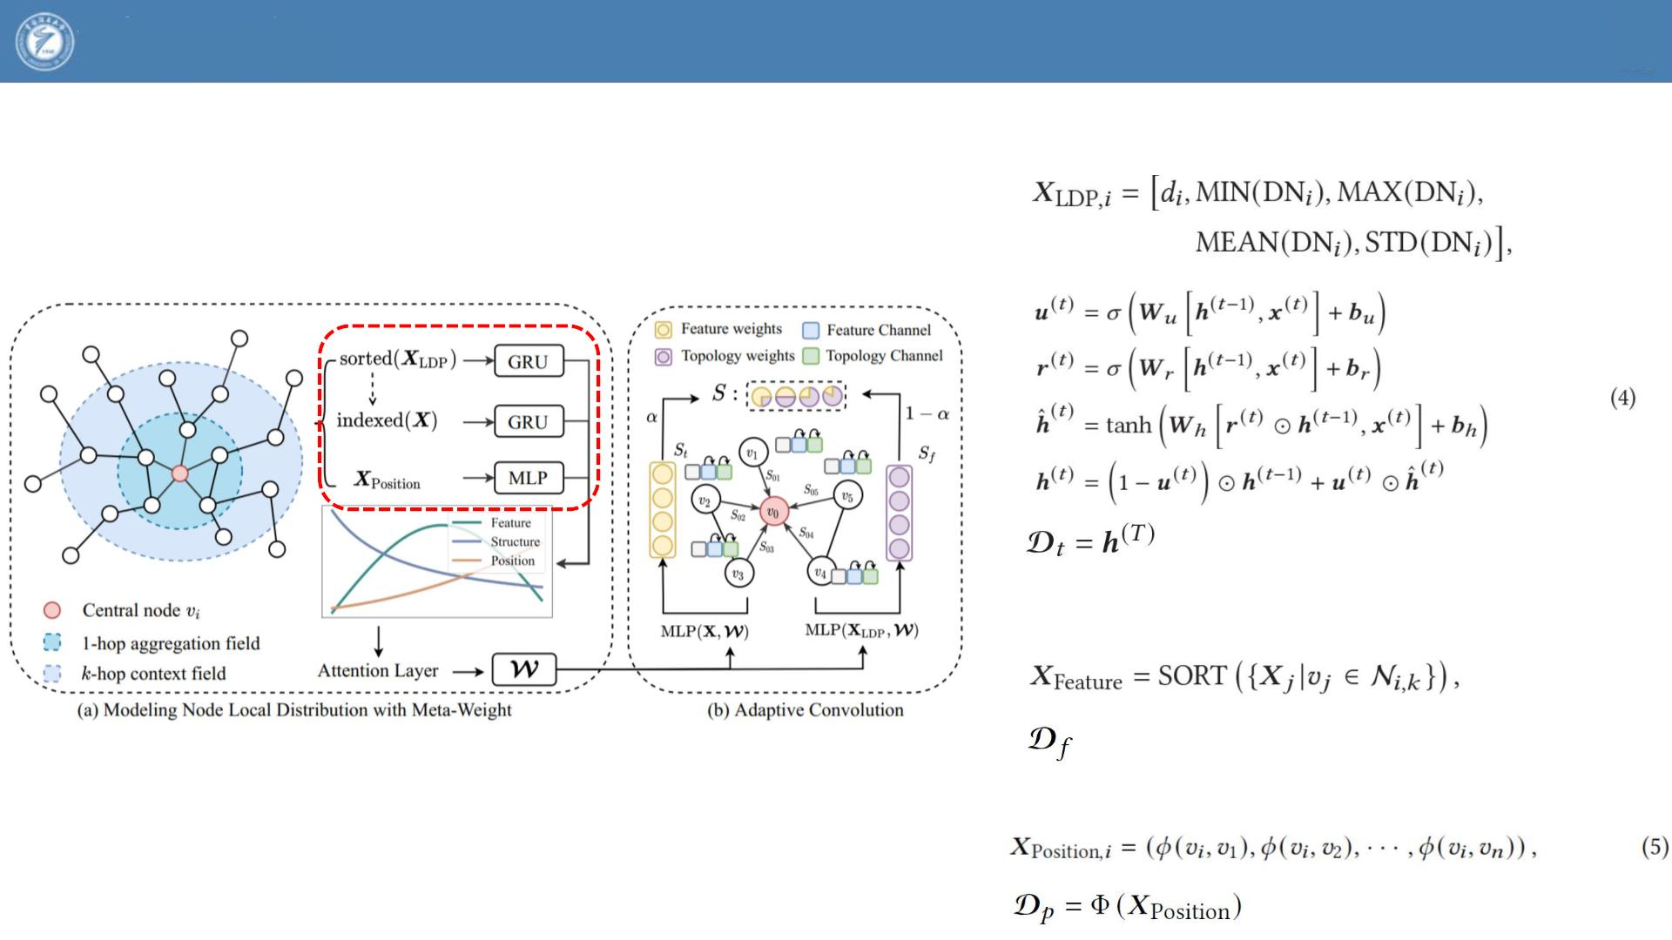
Chongqing University
of Technology
ATA I
Advanced Technique of
Artificial Intelligence
2020_WWW_Meta-Weight Graph Neural Network: Push the Limits Beyond Global Homophily

Slide 3
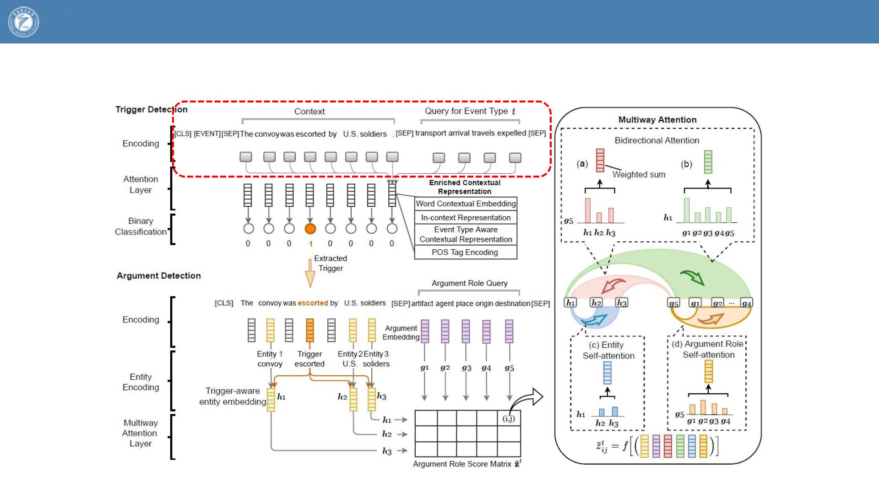
Chongqing University
of Technology
ATA I
Advanced Technique of
Artificial Intelligence
2022_ACL_Query and Extract Refining Event Extraction as Type-oriented Binary Decoding

